Slide 1

BUSINESS ECOSYSTEM AND NEW MARKET OPPORTUNITIES.

Slide 2
WHAT IS THE MEANING OF BUSINESS ECOSYSTEM?
"A business ecosystem is a business arrangement between two or more entities (the members) to create and share in collective value for a common set of customers.
Business ecosystems are networks of different entities that come together to accomplish something beyond the effective scope and capacity of any independent entity.

Slide 3
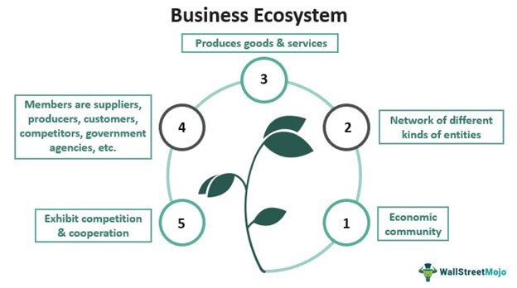
What are the Features of business ecosystem?

Slide 4
KEY TAKEAWAYS
Business ecosystems are networks of different entities that come together to accomplish something beyond the effective scope and capacity of any independent entity. Examples of significant types are the digital ecosystem and industrial ecosystem.
The participants and processes continually evolve to sustain the competition and meet the growing needs of the target market.
Examples of participants in the system are producers, suppliers, competitors, consumers, and government agencies.
Some of the categorizations of the system are solution ecosystem, transaction ecosystem, and hybrid ecosystem.

Slide 5
WHAT IS ECOSYSTEM STRATEGY?
A business ecosystem strategy focuses on a larger horizon inclusive of suppliers, makers of related products, competitors, technology providers, and a host of other organizations. It provides satisfying social, economic, and technological value. Hence it is about focusing more on the entities outside the business, primarily customers, and satisfying the customers requires continuous innovation and marketing.

Slide 6
NEW MARKET OPPORTUNITIES
It is a type of driver that motivate an organization to put together a Green IT strategy and undertake transformation, these drivers has resulted in a new market that was not visible a decade ago. This new market is based on the suite of opportunities that have opened up for creating and providing services and products that assist other organizations in achieving their green initiatives and goals. Thus, we are talking not only about "businesses that are green but “green as a business offering".
For example, the CEMS is a new software applications that is available in the market. The developers of these new software applications have discovered a market that did not exist earlier. Similarly, smart meters to measure carbon emissions, new design of low-carbon gadgets is a market that is likely to grow in the carbon economy.

Slide 7
Despite of drivers for businesses to undertake green initiatives, practical experience suggests that these drivers of a green strategy are usually interpreted by the organization in its own ways. Thus, in practice, these drivers will result in a combination of drivers for the business to initiate Green IT depending on what it considers as its own key environmental as well as business issues. For example, an organization may attempt to create a green business ecosystem through a green broadband or carbon-neutralizing your flight (such as booking air ticket on particular website). Thus, in the development of a Green IT strategy, not only do these drivers need independent analysis, but they also need to be studied together to see their overall impact on the organization.

Slide 8
IMPORTANCE OF NEW MARKET APPLICATION
It helps to identify the need of customers and according to plan, design and deliver the product and services for customers satisfaction.
It helps customer and company to stay ahead of a competition due to introduction of customers oriented products.

Slide 9
WHY BUSINESS NEED NEW MARKET OPPORTUNITIES?
Today in this competitive business environment constant growth in profitably are never a guarantee with advancement in technology.
Business model keeps changing and new competitor enter from various industries this makes its very crucial for business to seek new market opportunities to grow and stay ahead of competitor.

Slide 10
THANK YOU!

